Slide 1
CSE 471 Project 3
James Dodge, Edward Maxwell, James Torres, Wyatt Roehler, Kiera Wheatley

Slide 2

Player
Player controls a ship
Ship can move left to right and fire rockets

Slide 3
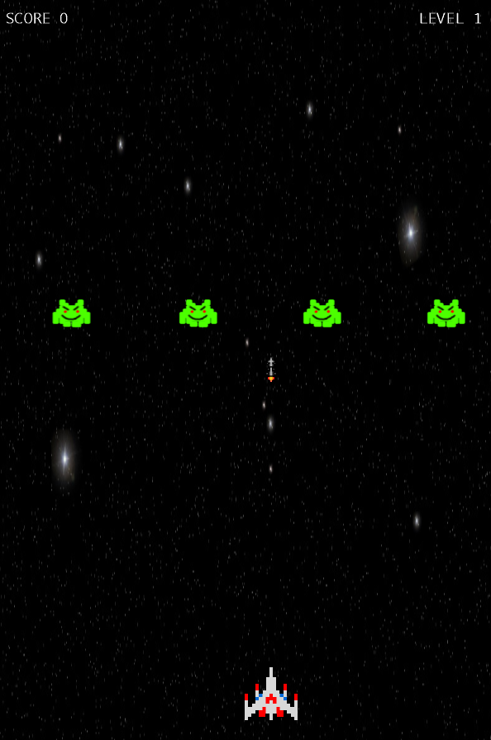
Controls
Left arrow key – Move left
Right arrow key – Move right
Space bar – Fire rocket

Slide 4




Levels
All enemies defeated → advance to next level
Enemies become faster
Enemy sprites change on certain levels
Enemies begin to shoot faster

Slide 5
Rockets
Enemy rockets are slower then ship rockets
Only ship rockets can destroy enemy
Ship has a limit to number of rockets allowed on a screen at a given time

Slide 6
Enemy Destroyed
Create Bounding Boxes for each enemy and each rocket
On every update, check to see if an enemy’s box overlaps with any of the user’s rockets
If there is a collision, destroy the enemy and the rocket
Increment the score counter

Slide 7


Sound
Game background music – Galaga 88 Galactic Dancing Big Band Jazz
Source: https://www.youtube.com/watch?v=HOwH7Ftf71w
Rocket Fire sound effect
Rocket Hit sound effect
Sound effects taken from: soundbible.com and audioblocks.com

Slide 8
Game Over
Game over is determined on multiple factors
If the enemy missile overlaps with the ship
The ship overlaps a enemy
The enemy has reached a level equal to or below the ship

